Slide 1
Heart Disease Prediction Model Report
By OLOMO AYOBAMI

Slide 2
Content Layout
Aim & Overview of the Prediction Model
Data Exploration
Model Development & Analysis
Important Features & Business Approach

Slide 3
Aim & Overview of the Prediction Model
The goal of this project is to develop a machine learning model that will detect if a patient has heart disease or not. Also, test the model with a heart disease dataset developed by Medical Practitioners in University Hospitals, Medical Centers and Cardiology Clinics in Cleveland.
This prediction model will be used by the hospital cardiologists. It will aid the cardiologists in reconfirming a patient has heart disease or not based on their symptoms and most crucial test results.
It will also be used by Clinical Laboratory Scientist and Nurses who work in heart specialist hospitals, Teaching and General Hospitals to determine the heart disease status of their patients.
13 attributes were used to determine the heart condition of each patient in the dataset.
13 attributes were used to build the heart disease prediction model.
The 13 attributes are the independent variables, and the target value is the dependent variable.
Independent Variables = clinical tests, symptoms and patients biometrics.
Dependent Variable = Heart Disease determination.
Our Machine Learning System is a Supervised Learning Model.

Slide 4
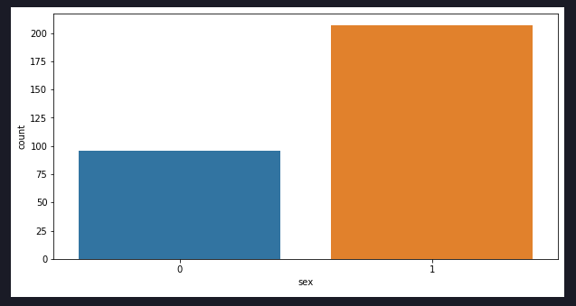
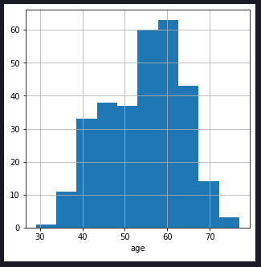
Data Exploration
Gender Results
Age Distribution
1 = FEMALE ; 0 = MALE

Slide 5
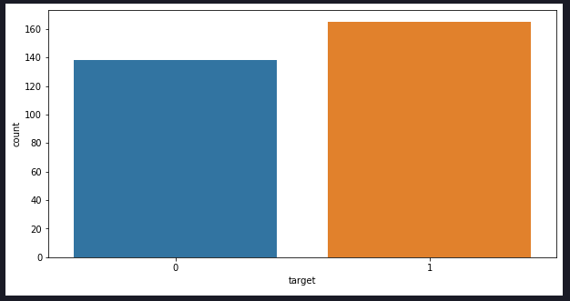
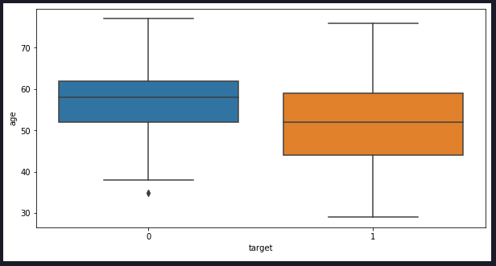
Data Exploration
Target Variable from Dataset
Heart Disease; 1 = Positive
0 = Negative
Target Variable vs Age
Is heart disease age related?

Slide 6
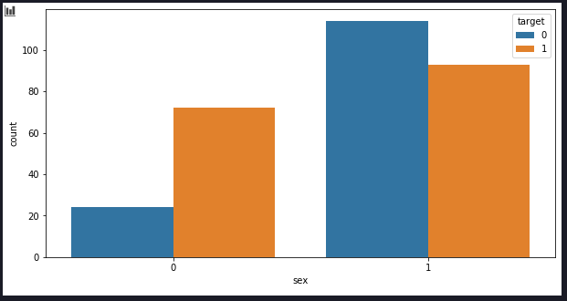
Target Variable vs Gender
Is heart disease gender related?

Slide 7
Model Development & Analysis
Iteration process & results

Slide 8
Iteration Process
The reasons for the iterative process are as follows:
To pick the model with the best performance.
Also, to discover the most important features that help the model to make a highly accurate prediction, and the attributes the doctors should look out for during their decision making process.
Lastly, to create a balanced model. That can true positives, true negatives, false positives and false negatives.
Step 1
Predictive Model Training & Testing
Use of 3 Tree Models and their default parameters.
Step 2
Predictive Model Training & Testing
Use of 3 Tree Models with finetuned parameters.
Step 3
Data Sampling
Placing the 3 Tree finetuned Models within a data sampling model.

Slide 9
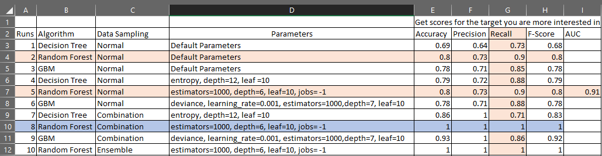
Table of Models Result
The best model for each sampling method is highlighted in pink.
The overall best model is highlighted in blue. It is the best model because it has the best accuracy score, it is a balanced model and it can accurately predict false negatives, true positives and has an impressive f1-score. This implies the model will be able to predict when a person has heart disease and when and vice versa.
I choose recall as the most important score.
It is detrimental to have false negatives for a heart disease condition.

Slide 10
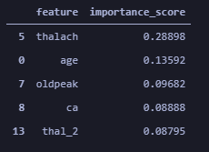
Important Features & Business Approach
These 4 attributes/ features are important tests that should be carried out on patients suspected for having heart disease.
Also the results of these 4 tests should be critically analyzed when carried out, in order to avoid mistakes in the diagnosis of patients.
Also age has a large role to play in heart disease conditions.

Slide 11

Thank You!!!
For your audience.

